Slide 1
1. Thrilled fans rushed lo see David Beckham as he arrived in Japan. 2. In order to celebrate my cousin's wedding, my uncle and aunt have arranged a party. 3. Karl Marx wrote some of his books on communism in the British Library, which has a splendid collection of books. 4. The ancient pots at the museum attract artists nationwide with their beautiful colours and excellent workmanship.

Slide 2
5. “Do not treat your cloths roughly”, said my mother. “They will last longer if you wash them carefully and fold them up neatly”. 6. The nice was gelling tenser all the lime. 7. The possibility of renting that furnished flat lo me is very small - the owner of the flat is asking too much money. 8. Royal families and ordinary families are alike. They often have disagreement and sometimes quarrel!

Slide 3
优雅的前沿的 2. 不管不顾
液体 4. 前进
5. 部门 6. 提名
7. 最小量 8. 密度
9. 监控 10. 拥挤堵塞

Slide 4
假定你是李华，贵校在学生中征集意见，询问学生是否赞成开设iPad课堂（iPad classrooms）。你支持开设iPad课堂；请给校长写一封建议信，要点如下：
1. 资源丰富；
2. 促进交流；
3. 利于环保；
4. 其他理由。
反思：写了几句话？每一句是什么句型？

Slide 5
是否赞成
from my perspective/ as far as I am concerned
approve of / advocate/ in favor of
资源丰富
countless abundant numerous
broaden mind/horizon
促进交流
Tighten / prompt / enhance communication
build a bridge between… .

Slide 6
利于环保
environmentally friendly/ eco-friendly/ low -carbon lifestyle
be made of / be made from
reduce the consumption
其他理由
inspire/stimulate /arouse the enthusiasm to study
boost students’ interest
reduce / relieve burden
first and foremost/ last but not the least/in a word/ in conclusion/ all in all/ above all/ to sum up

Slide 7
I am in favor of opening iPad classrooms because it is abundant in information resources, which allows us to get what we want conveniently. (钱景卓)
Compared with traditional classrooms, iPad classrooms provide us with abundant and diverse educational resources. (夏睿哲)
Ipad classrooms make it possible for us to build a bridge between teachers and students, promoting
their communication. (邵昊眀)

Slide 8
4. Unlike traditional teaching approaches, it is much more environmentally friendly based on the fact that we can reduce the use of paper which is made from wood if we open iPad classrooms. (杨诗静)
5. Last but not the least, living at a time when technology is developing at an extremely high speed,
we will be able to involve in the society with more ease in the future if we get used to using cutting-edge products. (唐佳婧)

Slide 9
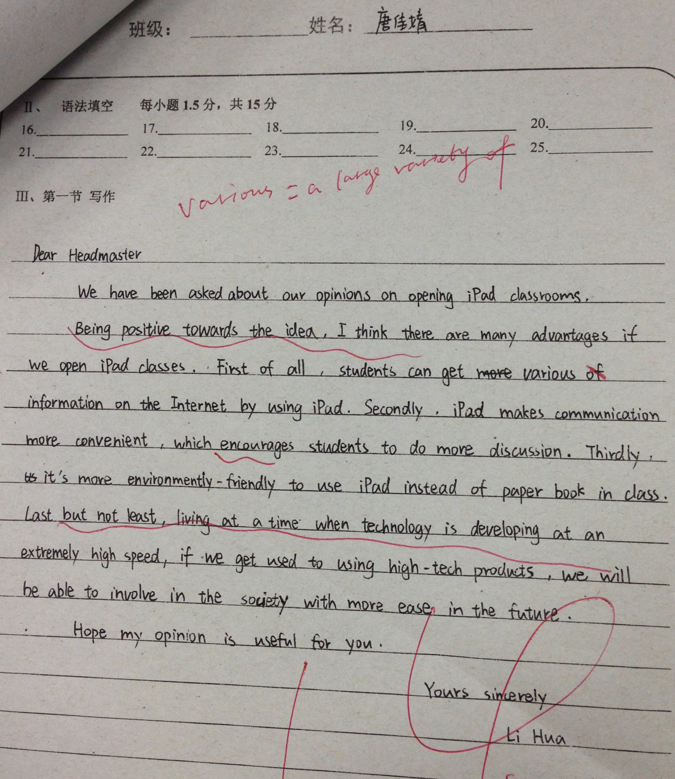

Slide 10
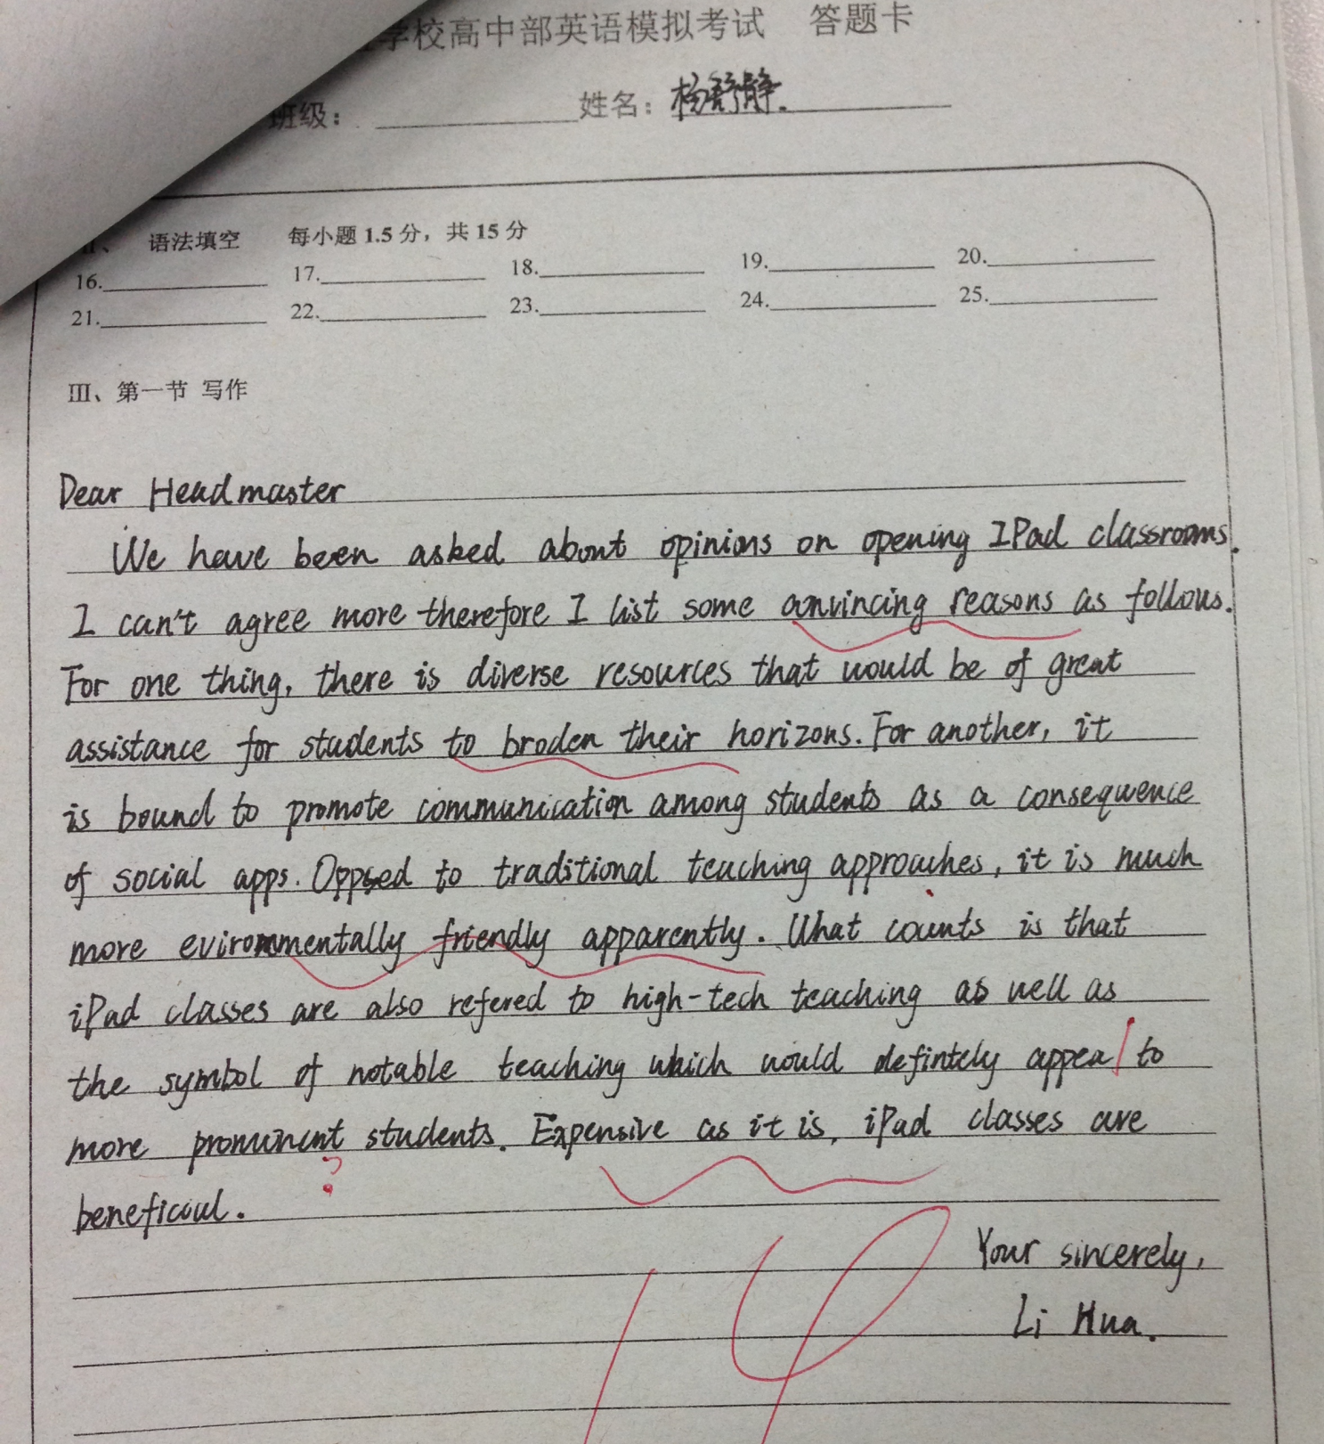

Slide 11
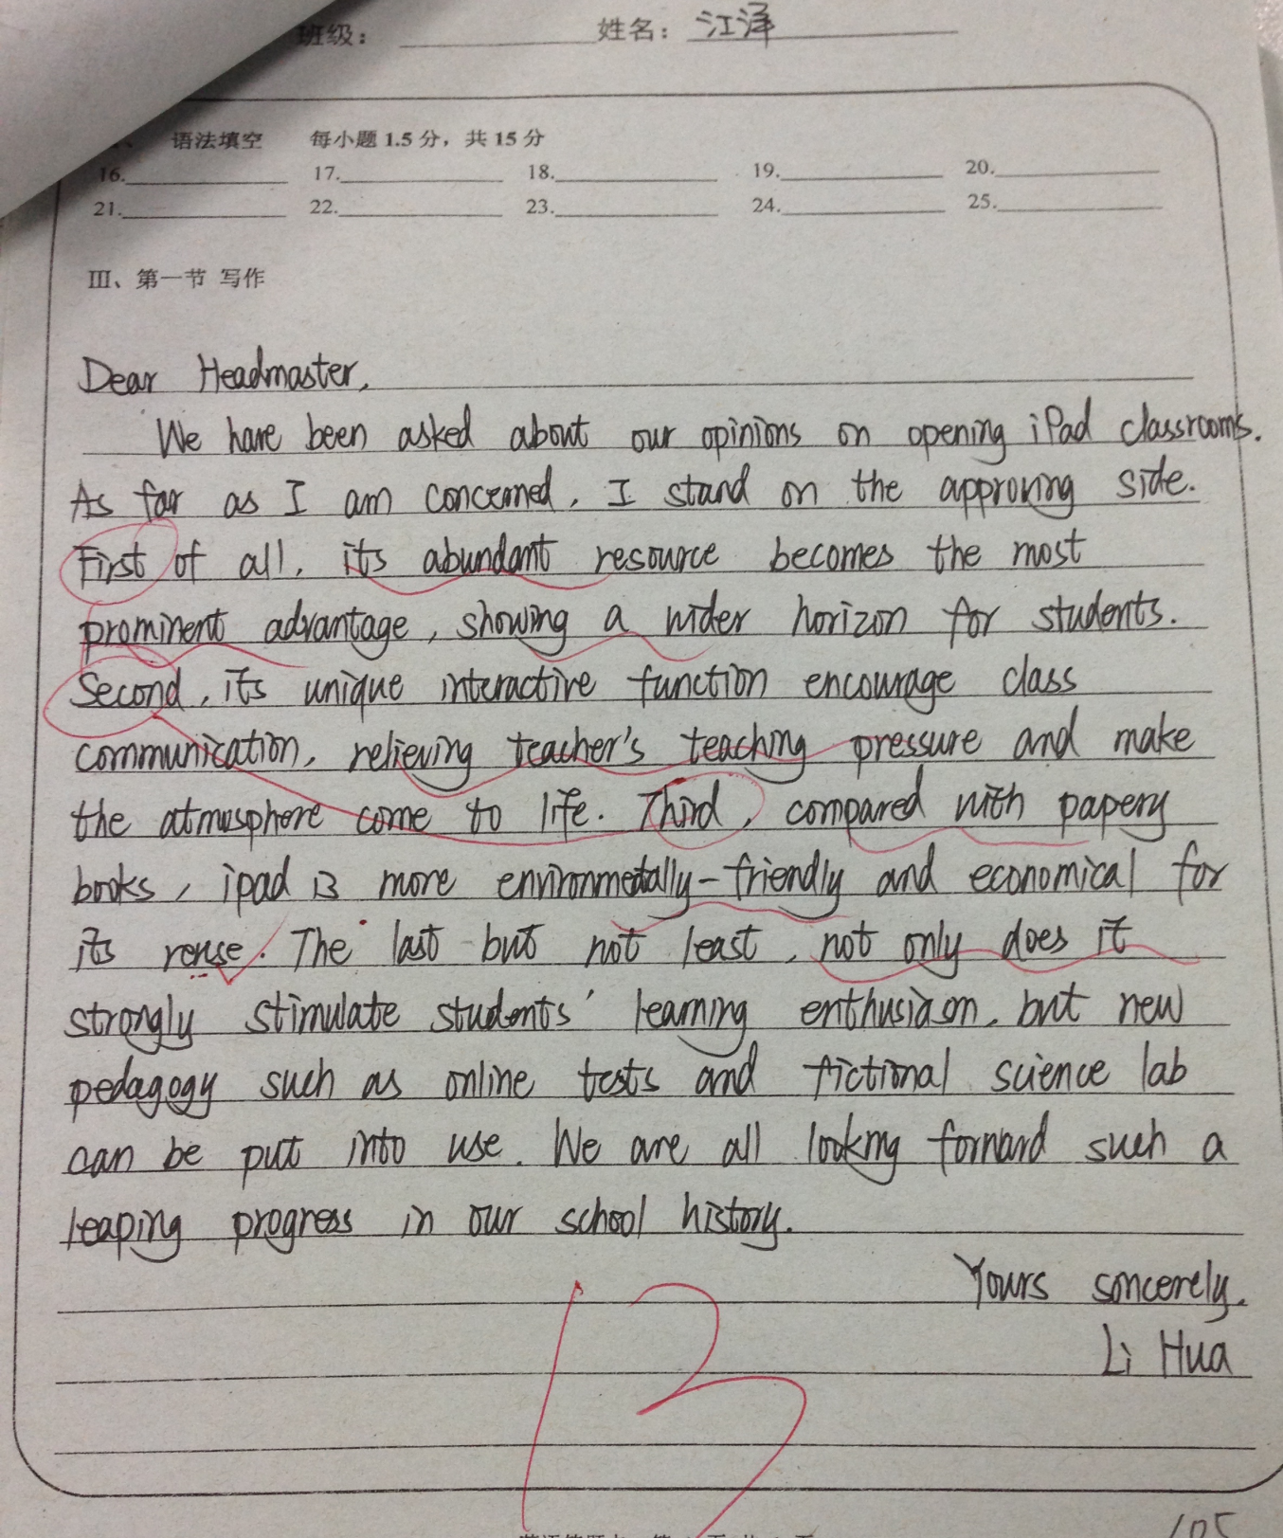

Slide 12
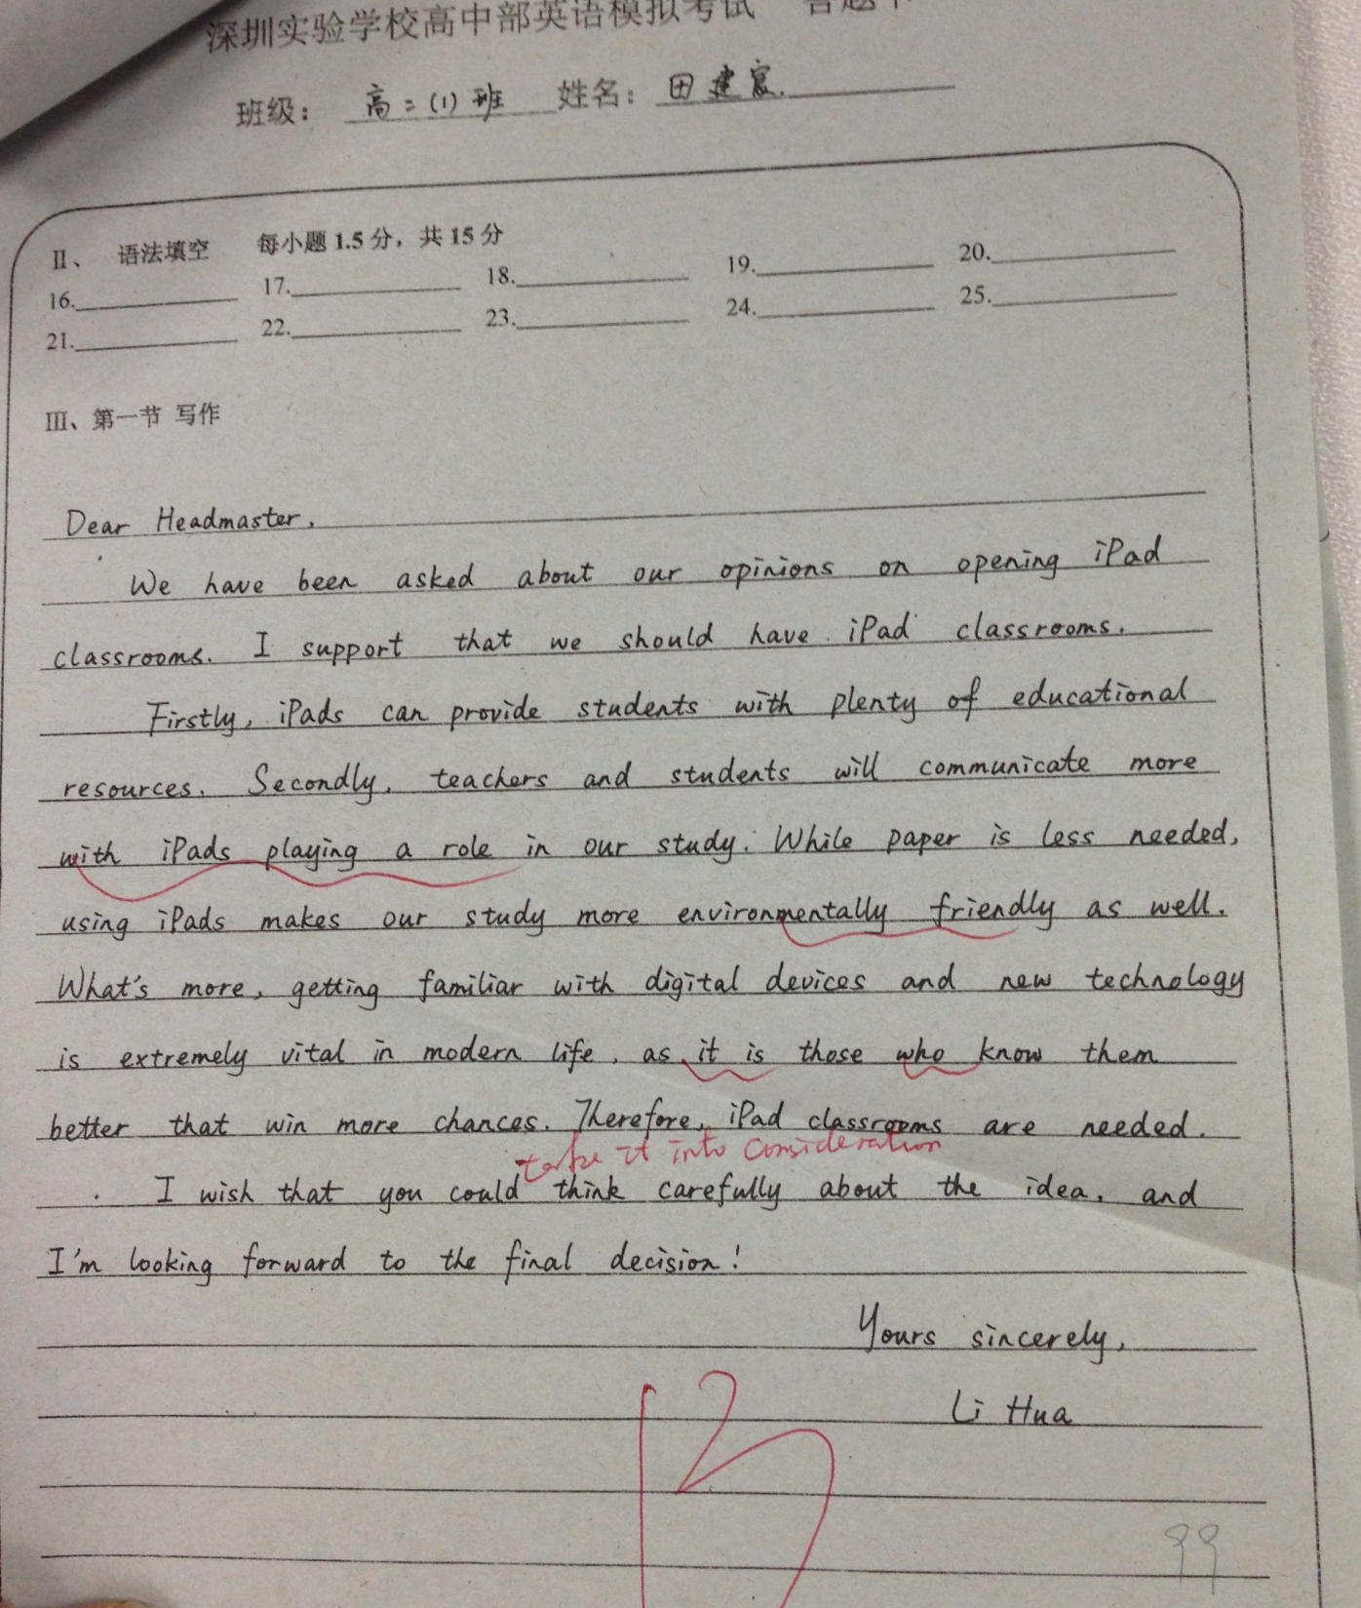

Slide 13
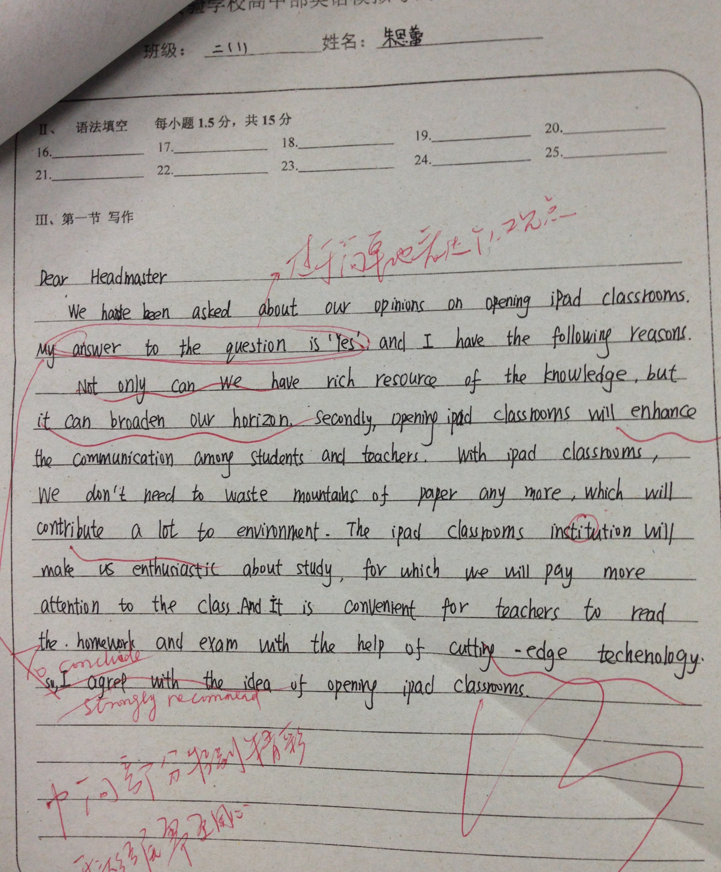

Slide 14
Dear Headmaster,
We have been asked about our opinions on opening iPad classrooms. I am in favor of this plan for the following reasons. To begin with, everyone learns differently. Students can customize their iPad with materials that fit their level and learning style, and thus tailor it to different needs. Moreover, when connected to the Internet, students can interact with teachers and classmates about what they learn more conveniently. For the sake of environmental protection, opening iPad classrooms is a good way to save trees that we have been cutting down for paper. Most importantly, I believe students will develop their interests in the subjects by enjoying a new way of learning.
I hope you would take my ideas into consideration and we look forward to attending an iPad class.
Yours sincerely,
Li Hua

Slide 15
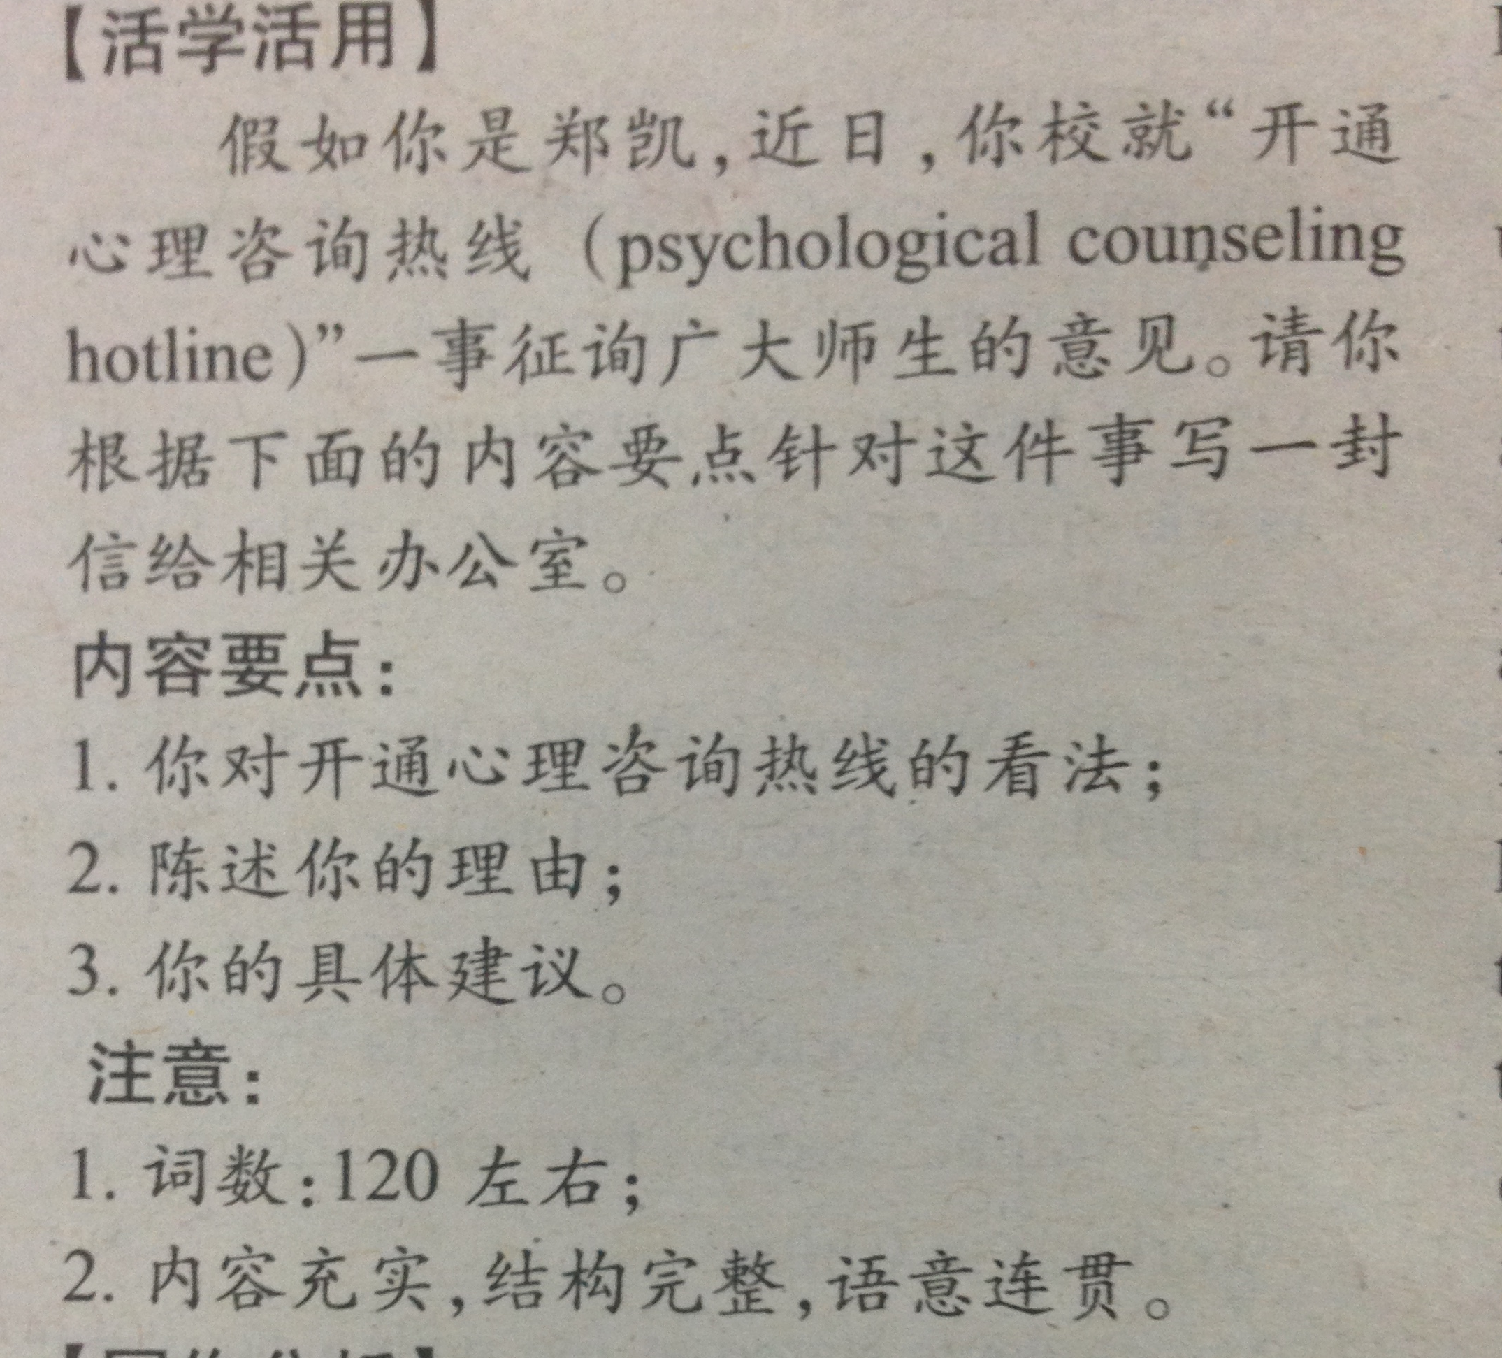

Slide 16
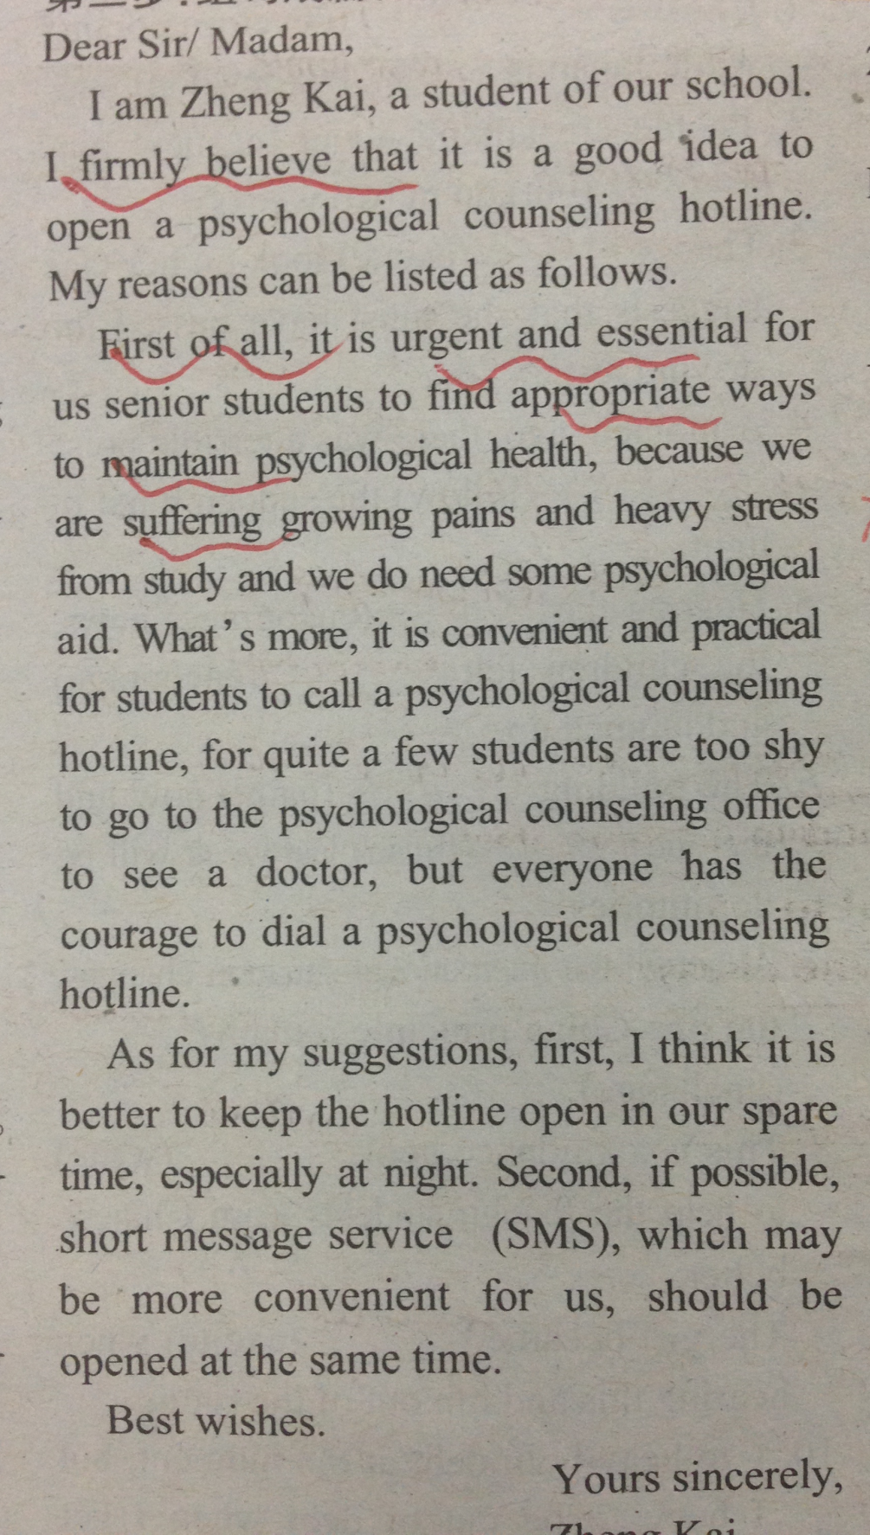

Slide 17
Assignment
1. 背诵范文（iPad classrooms）

